Slide 1
Payback Information Management System (PIMS): What’s Next?
October 31, 2019

Slide 2
Agenda
Update since launch of PIMS
Next steps for grantees and scholars
PIMS demonstration
PIMS top 10 list
Resources
Q and A

Slide 3
What’s next for grantees and scholars?

Slide 4
Update Since Launch of PIMS
Provided access to 133 Project Directors to report on 275 grants starting in mid-August
Wrapping up grantee data collection now
75 grants submitted all Scholar Records
1,505 submitted records for scholars who are still enrolled or fulfilling their obligation

Slide 5
Grantee Data Collection
Grantees MUST submit records for all pending scholars by November 8th
PIMS monitors and follows up with grantees who do not submit data on time
PIMS refers grantees who do not report data on time to RSA
Regulations require on time data submission and not submitting data on time can jeopardize current or future funding

Slide 6
Next Steps for Scholars
Scholars will review their contact and training information in the system
Scholars will submit employment data electronically
Grantees & employers will approve & verify employment information electronically

Slide 7
Scholar Launch
PIMS will email scholars with submitted records who are still enrolled or completing their service obligation
Instructions for accessing the system
Link to a recorded training
Help Desk contact information
Groups of scholars will be given access to PIMS every few weeks starting week of November 18th

Slide 8
Scholar Responsibilities
Scholars will submit their employment directly through PIMS for grantee review and employer verification
Scholars will only receive credit for eligible employment positions approved by the Project Director and verified by their employer
Scholars will not receive credit for any eligible employment positions held prior to their completion/exit from the program
Scholars are responsible for ensuring employers respond to the system-generated email requesting employer verification of reported employment

Slide 9
Scholar Responsibilities (cont.)
Scholars will submit requests for deferrals and waivers* and upload supporting documentation in PIMS
For deferrals, scholars will need to upload updated enrollment information annually
*Grantees should report to PIMS if they have knowledge that scholars
are deceased or severely ill. Grantees will be asked to obtain the death certificate for deceased scholars or other verification documentation necessary to process an exception or medical waiver.

Slide 10
What Can Grantees Do to Help Prepare Scholars?
Let scholars know to expect an email from RLTTHelpDesk@ed.gov
Ask them to review the Scholar Training and MFA resources https://pdp.ed.gov/RSA/Home/Training
Provide scholars with the PIMS Help Desk info RLTTHelpDesk@ed.gov 1-800-832-8142

Slide 11
Grantee Review of Scholar Employment
Grantees will review scholars’ employment information to determine if it is eligible for payback consistent with the program regulations
Decision will trigger an email notification to scholar
Approval will also trigger employment record to be sent to employer for verification
Notes:
Project Director must approve employment in order for a scholar to receive credit
Criteria used to determine qualified employment has not changed

Slide 12
Grantee Responsibilities in PIMS: Ongoing Actions
Grantees will:
Update Scholar Records at least annually as long as the scholars are receiving funding
Create new Scholar Records for any newly-enrolled scholars
Grantees will not need to update Scholar Records for scholars after they graduate/exit prior to completing the program

Slide 13
Grantee Responsibilities in PIMS: Ongoing Actions (cont.)
Grantees should create records for scholars in PIMS within 30 days of when a scholar is enrolled in the program
Grantees should update scholar contact and service obligation information within 30 days of scholar changes in status
Grantees MUST update all Scholar Records at the conclusion of the grant’s project year
At a minimum, we would expect grant personnel to be updating data in the system every six months

Slide 14
Grantee Ongoing Scholar Reporting
For scholars who are still enrolled, grantees will need to update the following sections on each Scholar Record at least annually:
Section D: Upload a new Payback Agreement (if applicable)
Section F: Current Training Program Information
Question #4: Full or part-time enrollment
Question #5: Funding Amount
Question #6: Employment while enrolled in the program
Section G: Scholar Status
Question #1: Scholar status
Question #2: Accumulated academic years of funding
Sections H & I: Completed as soon as scholars exit/graduate

Slide 15
PIMS: Live Demonstration
We will now demonstrate the following activities in the PIMS:
Updating Scholar Record
Approving scholar employment
Scholar pages

Slide 16
Top 10 Things You Need to Know About PIMS

Slide 17
#10 — Secondary Users are Great!
Set up a secondary user if you want someone else with the grant to be able to enter scholar information. However, the Project Director is held responsible for all data entries
Each person should have a unique log in to the system. Do not share your password with anyone — add a secondary user
Only one secondary user is permitted access per grant

Slide 18
# 9 — Emails from RLTTHelpDesk@ed.gov Should Always Be Read
Please add RLTTHelpDesk@ed.gov to your contact list
Check your email settings to be sure emails from this account are not marked as spam or junk
Let scholars know to expect emails from RLTTHelpDesk@ed.gov

Slide 19
#8 — MFA is Required
You only need to install MFA on your phone once
You will need to enter a new code from Google Authenticator each time you login for MFA
Review MFA resources https://pdp.ed.gov/RSA/Home/Training

Slide 20
#7 — Ask Scholars for a Non-University Email for PIMS
We must be able to reach scholars after they graduate or leave the university, so please enter a non-university email address for each scholar
Personal email (e.g., gmail, yahoo, Outlook)
Work email
Include a second non-university email, if the scholar has multiple emails, in the alternative email field

Slide 21
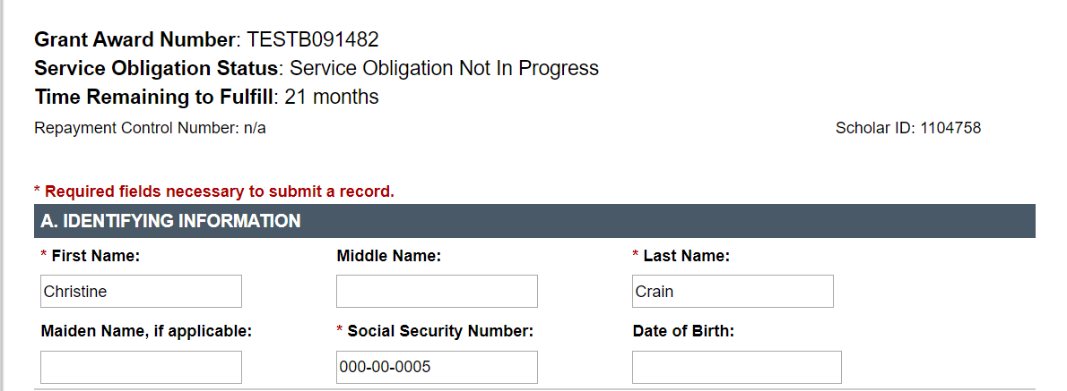
#6 — Reminder to Scholars
Once scholars have access to PIMS, remind them to review and update contact information and enter employment

Slide 22
#5 — Responses to Section F Questions 4, 5 and 6 Must be Consistent

Slide 23
#4 — Resetting Your Password

Slide 24
#3 — Repayment, Deferral and Waiver Referrals/Requests are Processed by PIMS
PIMS will identify scholars who potentially need to be submitted for repayment.
Scholars will submit requests for deferral and waivers through PIMS

Slide 25
#2 — Completed and Signed Agreements are Required!
For each scholar who receives funding, grantees must upload completed and signed Payback Agreements
You will not be able to submit Scholar Records without uploading a Payback Agreement
Please contact the Help Desk as soon as possible if you do not have scholars’ Payback Agreements
Grantees may be held responsible for funds provided to scholars for whom they do not have agreements
Grantees must retain grant records until all service obligation has been fulfilled or paid back
Notes:
The exit certification form is needed as well, but we recognize this form is not always returned by the scholar. An explanation should be entered if the exit certification form is not uploaded.

Slide 26
#1 — When to Update in PIMS
Grantees should create a record for a scholar in PIMS within 30 days of when a scholar is enrolled in the program
Grantees should update information within 30 days of scholar changes in statuses
Grantees MUST update all Scholar Records at the conclusion of the grant’s project year (during the fall data collection period)

Slide 27
Reminders & Resources

Slide 28
Service Obligation Reminders
Scholars who receive funds after September 2016 and leave the program prior to completing one year may not repay the obligation through service
Criteria used to determine qualified employment has not changed
Grantees will still assist scholars in identifying names and addresses of qualifying employers

Slide 29
Service Obligation Reminders (cont.)
The Project Director and employer must approve/verify employment for a scholar to receive service obligation credit
If scholars do not secure qualifying employment by the time the service obligation becomes effective, they will be referred for repayment
Notes:
PIMS identifies scholars who may need to be referred for repayment based on employment reported in PIMS.

Slide 30
Reminders Regarding Documentation
For repayment referrals to be processed, PIMS must have the signed and completed Payback Agreement on file for scholar
Grantees are responsible for uploading these agreements to PIMS for each scholar
Dates, amount, grant number, etc. on the Exit Certification must match the information entered in PIMS

Slide 31
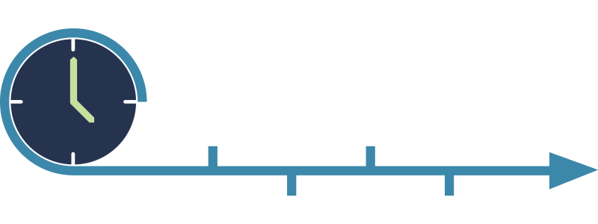
Timeline
All Project Directors have access to PIMS
Scholars will be able to access PIMS in late November to enter employment information

Slide 32
Additional Resources
PIMS Training and Resources: https://pdp.ed.gov/RSA/Home/Training
FAQs: https://pdp.ed.gov/RSA/Home/faq/

Slide 33
Contact Us
Email RLTTHelpDesk@ed.gov or call
1-800-832-8142 with questions or comments
The Help Desk is available Monday through Friday from 8am–8pm (Eastern Time)

